Slide 1
CAN Bus Arbitration
AGENDA
What is Bus Arbitration
How bus arbitration works
Demo of Bus Arbitration
Shyam Bhat
VicharaVandana

Slide 2
Bus Arbitration
If multiple nodes wants to transmit frame simultaneously on the bus, the conflict is resolved by a process called Bus Arbitration
SOF, Message ID and RTR bits participate in bus arbitration and are together called Arbitration field.
The node which wins the bus arbitration becomes the Transmitter node and gets to send its complete frame and other nodes become Rx node.
The nodes which lost arbitration will try to transmit their frames again once the bus becomes IDLE
If Two nodes tries to put different bits on the bus simultaneously the bus will take the dominant bit value and ignore the Recessive bit

Slide 3
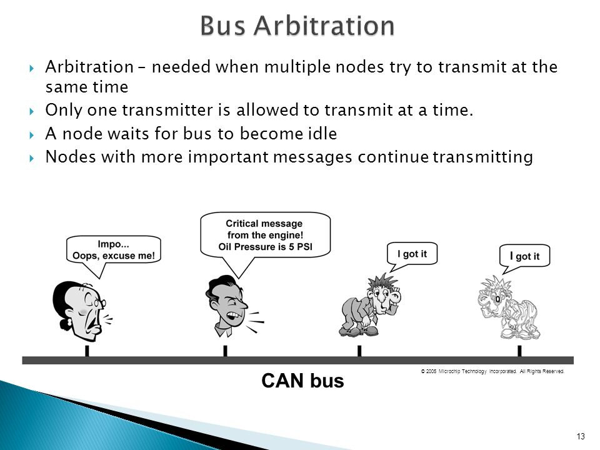

Slide 4
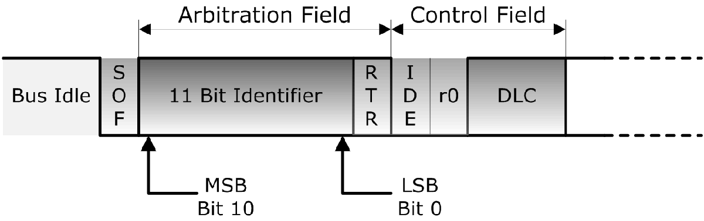
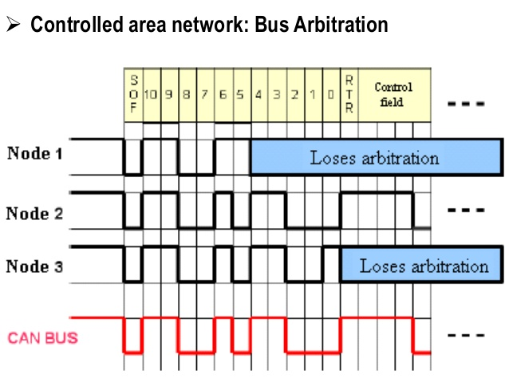
• Bit wise arbitration across the
Arbitration Field
• Dominant Bus Level = 0,
Recessive Bus Level = 1

Slide 5
Main Rules of Bus Arbitration
• Bus is considered idle after transmitted message plus Intermission Field
• Node that transmits message with lowest ID (highest priority) wins arbitration, continues to transmit. Competing nodes switch to receiving mode.
• Nodes that lost arbitration will start new arbitration as soon as bus is free for access again => No message gets lost

